Slide 1
NAWI RO Analysis Progress Report
SGDC
W. Kumagai, H. Soya, R. Imoto
Operational Excellence Gr., Project Design Dev.,
Innovation Center, MKHQ, YHQ
August 30th, 2023

Slide 2
Agenda
RO Operation Optimization
RO Permeate Water Quality Prediction / Q&A
RO Optimization Simulation / Q&A
RO Membrane Scaling Modeling / Q&A
Notes:
This is today’s agenda. There are three parts, first part is RO Permeate Water Quality Prediction, second part is RO Membrane Fouling Modeling, third part is RO Optimization Concept. We’ll have a Q&A in final part. If you have any questions, please save them until the end.

Slide 3
Objective of RO Optimization
1. RO Operation Optimization
Chemical dosing costs are minimized considering RO membrane condition within the range of maintaining water quality and flow rate.
Maintaining high recovery rate, good water quality (high salt rejection), and extending RO membrane life.
Considering water quality, permeate flow rate, and RO clogging status.
Subject to be optimization target if interchangeable with RO.
Chemical costs
Chemical costs
Sulfuric Acid／Anti-Scalant
Membrane cleaning
UV Radiation with H₂O₂ or NaClO
NaClO
UF
RO
UV / AOP
Potable Water
Given Region
Water quality and flow rate to be maintained
Given Region
Degree of Clogging
Water quality
Clogging due to fouling Scaling by crystallization Bio-fouling by deposit
Membrane life
Notes:
First, I explain RO data analysis and optimization policy. This shows potable water reuse process. Water from sewage plant is treated by this process and supplied to potable reuse.
It mainly consists of UF, RO, UV, and AOP process units. The objective of RO optimization shows operating costs are ~. There are important costs in many places, for example, chemical cost, RO membrane cleaning cost, and electricity cost. Moreover there are considering conditions in many places, for example, recover rate, water quality, and RO membrane life. So, optimization strategy is to select critical costs and conditions according to priority.
Based on the stages, RO analytical policy is to expand the control and considered value step by step. First stage is to control and consider yellow values. Green values are added in second stage and red values are added in third stage as well. But, gray regions are considered as given area in RO optimization, so they are fixed to actual value when calculation.

Slide 4
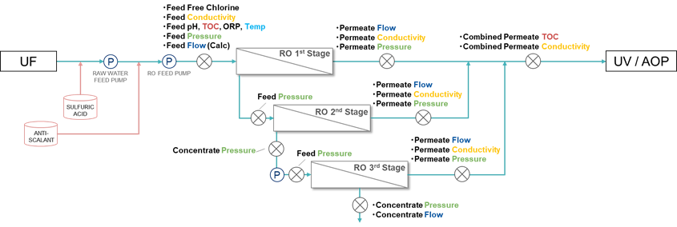
1. RO Operation Optimization
Overall view of LVMWD RO system
3 Stages configuration.
Water quality data is RO permeate TOC and Conductivity.
Monitoring LRV (logarithmic reduce value) as water-quality standards.
RO system
Water Quality Targets are shown in red.
measuring point
P
pump

Slide 5
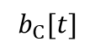
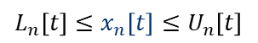
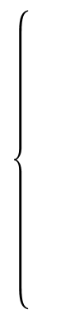
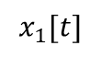
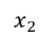
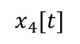
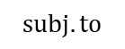
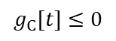
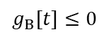
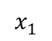
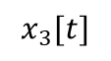
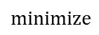
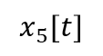
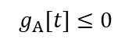
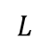
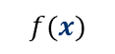
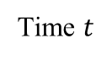
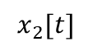
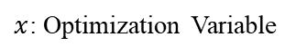
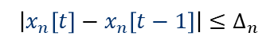
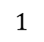
Plant Scheduling Optimization
1. RO Operation Optimization
1. Drawing Flow Chart
2. Formulation
Optimization Problem
3. Calculation
Operational Schedule
RO optimization problem is formulated into a scheduling optimization.
The procedure consists of the following steps.
Sample Flow Chart
$$minimize$$
$$f(x)$$
(Operational Cost)
$$subj.to$$
$$x_{1}$$
$$x_{1}[t]$$
A
$$x_{3}[t]$$
$$L_{n}\left[t\right]≤x_{n}\left[t\right]≤U_{n}\left[t\right]$$
$$x_{5}[t]$$
C
$$b_{C}[t]$$
$$\left|x_{n}\left[t\right]−x_{n}\left[t−1\right]\right|≤∆_{n}$$
$$x_{2}$$
B
$$x_{4}[t]$$
$$x_{2}[t]$$
$$g_{A}[t]≤0$$
$$g_{B}[t]≤0$$
(Facility Characteristics)
$$1$$
Time $t$
$$L$$
Facility Model
$x$: Optimization Variable
$$g_{C}[t]≤0$$
Operational Cost is $XX.
Notes:
RO optimization problem is formulated into a plant scheduling optimization. The procedure~. First step is drawing flow chart. In this chart, arrows connecting objects are assigned optimization variables. The object plays the role of exogenous variable, mathematical model, and predictive variable. Second step is formulation optimization problem. I define the minimizing the objective function and the constraints. Third step is calculation operational schedule. I solve the formulated problem using optimization algorithm.

Slide 6
Desktop Evaluation Flow Chart
1. RO Operation Optimization
Plant Info. Check
Step1
Check the plant flow & data
Check the plant flow chart, control & manipulated variable, evaluation index, and data trends.
Decide optimization story and modeling way.
Model Construction
Step2
Construct and validate the plant model
Detailed in Section 2
Construct the plant model including water quality prediction models.
Especially prediction models are validated individually.
Optimization
Step3
Execute optimization simulation
Detailed in Section 3
Implement the optimization problem and optimizer.
Execute simulation and validate/check the behavior.
Effect Calculation
Step4
Calculate the optimization effect
Compare optimization results with operation actual data in the past.
Notes:
We have taken the following chart.

Slide 7
Agenda
RO Operation Optimization
RO Permeate Water Quality Prediction / Q&A
RO Optimization Simulation / Q&A
RO Membrane Scaling Modeling / Q&A
Notes:
This is today’s agenda. There are three parts, first part is RO Permeate Water Quality Prediction, second part is RO Membrane Fouling Modeling, third part is RO Optimization Concept. We’ll have a Q&A in final part. If you have any questions, please save them until the end.

Slide 8
Today’s Topic Agenda
2. RO Permeate Water Quality Prediction
2.1 Introduction: summary up to the previous meeting
Data Preprocessing, Prediction model
2.2 Prediction and Preprocessing Results
Prediction by Multiple Regression Model and Random Forest
Minor Manual Preprocessing for Permeate TOC Data

Slide 9
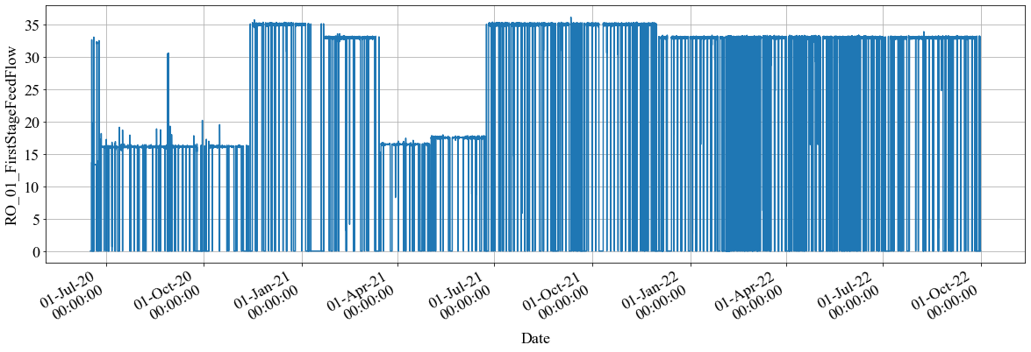
Data Preprocessing
2.1 RO Permeate Water Quality Prediction > Introduction
Creating “master data“ for analysis from raw dataset by pretreatment.
Step1: Local Rule based Filtering
Getting rid of the data during the period as the following three rules.
Step2: Systematic Rule based Filtering
“3σ Variance” or “Kalman Filter” is applied only when Step1 does not filter outliers enough.
Feed Flow Rate Raw Data (1minute span)
Local Rules in Step1
(1)
(2)
(3)
y=0
More than 10 min
Changing rate
More than 20%
Y
Y
Y
DATE
DATE
DATE
Value is 0
Constant value lasts long term
Changing Rate is high

Slide 10
Sequential Prediction (1 week Training and 1 week Prediction)
2.1 RO Permeate Water Quality Prediction > Introduction
Training
Training
Training
Training
We
e
k 1
We
e
k 2
We
e
k 2
We
e
k 3
We
e
k 3
We
e
k 4
We
e
k 55
We
e
k 56
predict
predict
predict
・・・
predict
Prediction trend
We
e
k 2
We
e
k 3
We
e
k４
We
e
k 56
“Prediction trend” is totally compiled with each weekly prediction trend all through the period.
・・・

Slide 11
Today’s Topic Agenda
2.2 RO Permeate Water Quality Prediction > Prediction and Preprocessing Results
Multiple Regression Model
A-1：Prediction results from systematically pre-processed data
Target① / Target④
A-2：Difference in prediction results with and without preprocessing
Radom Forest（New Approach）
B-1：Prediction results from systematically pre-processed data with Radom Forest Model
Target① / Target④
B-2：Difference in prediction results between Multiple Regression Model（A-1） and Radom Forest Model（B-1）
B-3：Consideration of B-2 （Characteristics of Random Forest）
Extra Trial（variation of A-1 and B-1：systematically pre-processing with minor manual tuning）
A-1-α：Prediction results from systematically pre-processing with minor manual tuning
B-1-α：Prediction results from systematically pre-processing with minor manual tuning

Slide 12
Today’s Topic Agenda
2.2 RO Permeate Water Quality Prediction > Prediction and Preprocessing Results by MLR
Multiple Regression Model
A-1：Prediction results from systematically pre-processed data
Target① / Target④
A-2：Difference in prediction results with and without preprocessing
Radom Forest（New Approach）
B-1：Prediction results from systematically pre-processed data with Radom Forest Model
Target① / Target④
B-2：Difference in prediction results between Multiple Regression Model（A-1） and Random Forest（B-1）
B-3：Consideration of B-2 （Characteristics of Random Forest）
Extra Trial（variation of A-1 and B-1：systematically pre-processing with minor manual tuning）
A-1-α：Prediction results from systematically pre-processing with minor manual tuning
B-1-α：Prediction results from systematically pre-processing with minor manual tuning
・・・P13~16

Slide 13
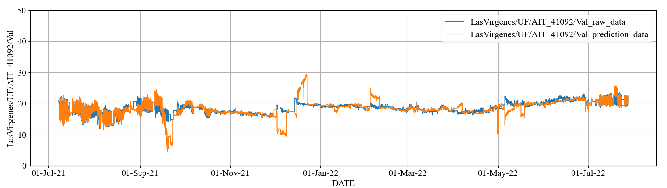
2.2 RO Permeate Water Quality Prediction > Prediction and Preprocessing Results by MLR
Prediction results by Multiple Linear Regression
Stage1 Permeate EC [uS/cm]
Pre-processed actual data
Predicted data
Index | Stage1 Permeate EC
RMSE | 1.88 (uS/cm)
MAPE | 5.24 (%)

Slide 14
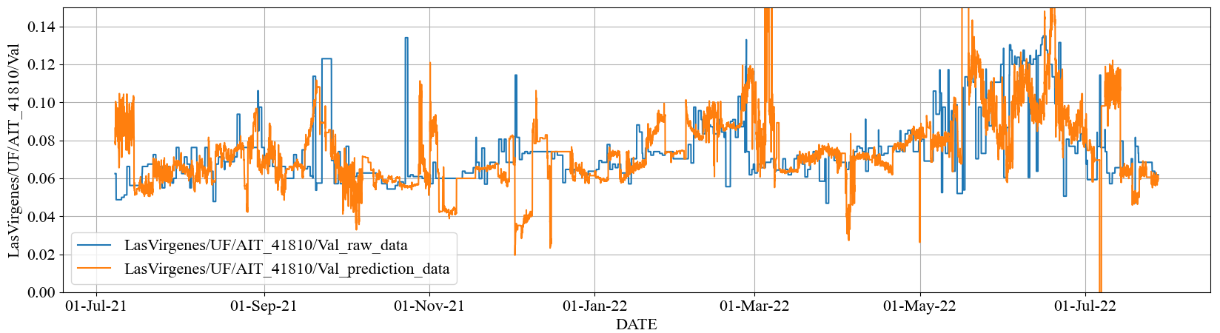
2.2 RO Permeate Water Quality Prediction > Prediction and Preprocessing Results by MLR
Prediction results by Multiple Linear Regression
Combined Permeate TOC [mg/L]
Pre-processed actual data
Predicted data
Index | Combined Permeate TOC
RMSE | 0.023* (mg/L)
MAPE | 18.46* (%)

Slide 15
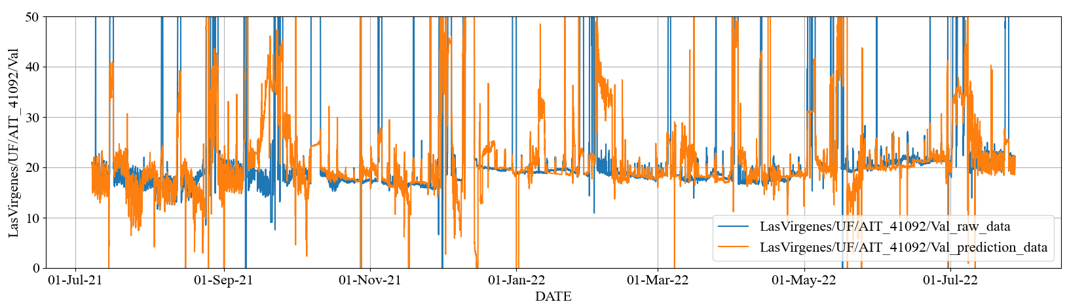
2.2 RO Permeate Water Quality Prediction > Prediction and Preprocessing Results by MLR
Impact of Preprocessing on Prediction
Difference in prediction results with and without preprocessing.
Stage1 Permeate EC [uS/cm]
preprocessing

Slide 16
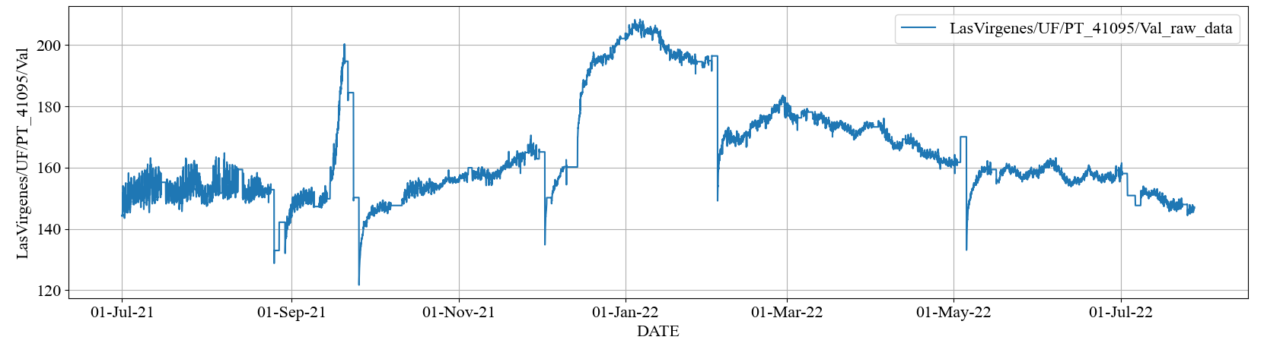
2.2 RO Permeate Water Quality Prediction > Prediction and Preprocessing Results by MLR
Impact of Data Disturbance on Prediction
①
②
③
④
⑤
Target ① Stage1 Permeate EC
①
②
③
④
⑤
Feed Pressure

Slide 17
Today’s Topic Agenda
2.2 RO Permeate Water Quality Prediction > Prediction and Preprocessing Results by Random Forest
Multiple Regression Model
A-1：Prediction results from systematically pre-processed data
Target① / Target④
A-2：Difference in prediction results with and without preprocessing
Radom Forest（New Approach）
B-1：Prediction results from systematically pre-processed data with Random Forest
Target① / Target④
B-2：Difference in prediction results between Multiple Regression Model（A-1） and Random Forest（B-1）
B-3：Consideration of B-2 （Characteristics of Random Forest）
Extra Trial（variation of A-1 and B-1：systematically pre-processing with minor manual tuning）
A-1-α：Prediction results from systematically pre-processing with minor manual tuning
B-1-α：Prediction results from systematically pre-processing with minor manual tuning

Slide 18
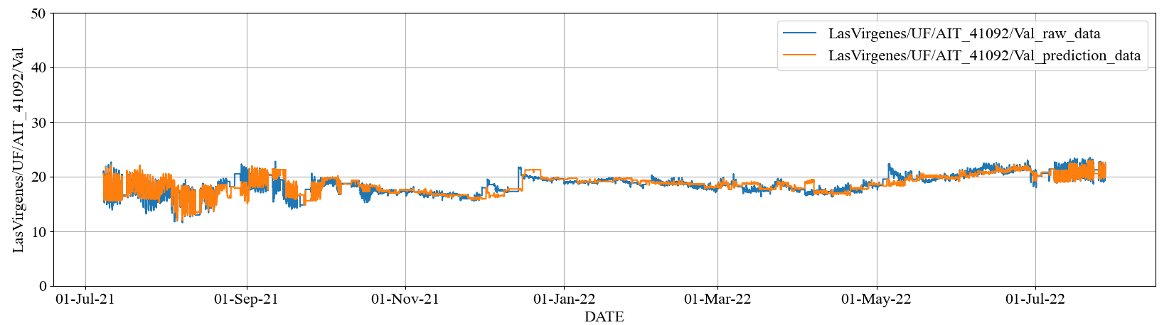
2.2 RO Permeate Water Quality Prediction > Prediction and Preprocessing Results by Random Forest
Prediction results by Random Forest
Stage1 Permeate EC [uS/cm]
Pre-processed actual data
Predicted data
Index | Stage1 Permeate EC
RMSE | 0.88 (uS/cm)
MAPE | 3.20 (%)

Slide 19
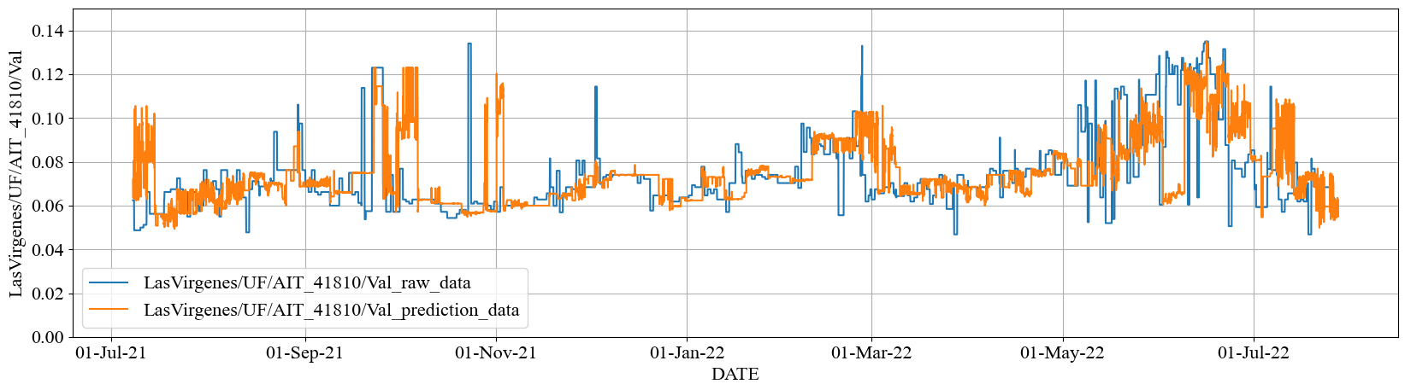
2.2 RO Permeate Water Quality Prediction > Prediction and Preprocessing Results by Random Forest
Prediction results by Random Forest
Combined Permeate TOC [mg/L]
Pre-processed actual data
Predicted data
Index | Combined Permeate TOC
RMSE | 0.017 (mg/L)
MAPE | 15.02 (%)

Slide 20
2.2 RO Permeate Water Quality Prediction > Prediction and Preprocessing Results
Comparing MLR and Random Forest
Stage1 Permeate EC [uS/cm]
①
②
③
④
⑤
Multiple Regression Model
①
②
③
④
⑤
Radom Forest

Slide 21
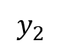
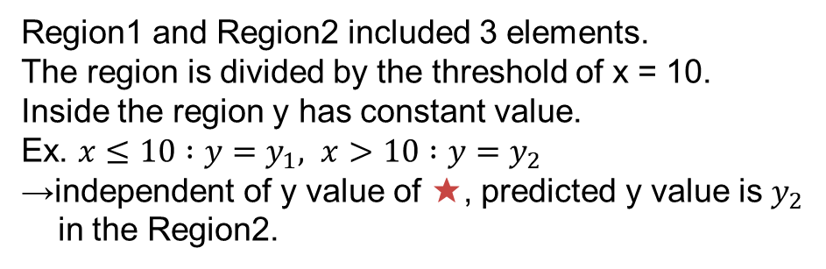
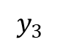
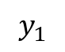
2.2 RO Permeate Water Quality Prediction > Prediction and Preprocessing Results
Consideration: Characteristics of Random Forest
Example: different impact of outlier depending on Models
Radom Forest Model
Linear Model
y
y
★
Outlier
Learned model
★
Outlier
Learned model
$$y_{3}$$
Region１
Region2
Random forest Model is more stable to outliers
$$y_{2}$$
★
★
$$y_{1}$$
10
x
x
Region1 and Region2 included 3 elements.
The region is divided by the threshold of x = 10.
Inside the region y has constant value.
Ex. $x≤10 :y=y_{1}, x>10 :y=y_{2}$
→independent of y value of ★, predicted y value is $y_{2}$
in the Region2.
The predicted y value depends on x value of ★.
→The predicted y value is y3 in the proportion of x value of ★.

Slide 22
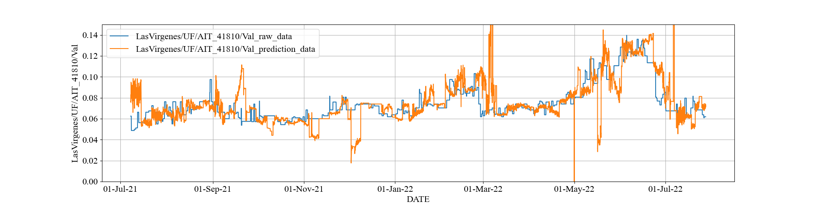
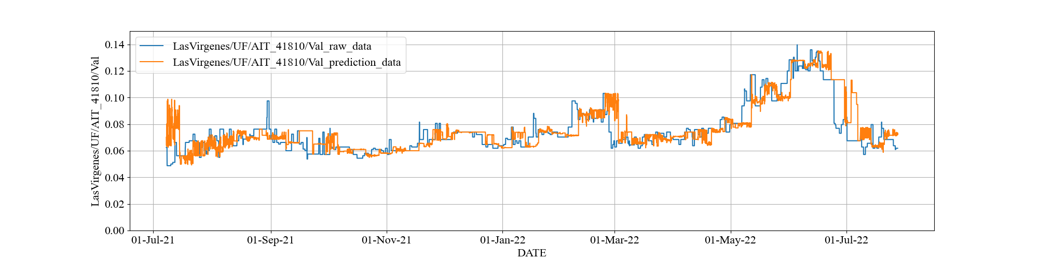
2.2 RO Permeate Water Quality Prediction > Minor Manual Preprocessing
Changing Pretreatment Parameters for Permeate TOC
Minor manual tuning is effective to minimize the error value. But tuning performance is highly influence of artifact.
Combined Permeate TOC [mg/L]
Multiple Regression Model
Radom Forest
A-1
B-1
Before
minor manual tuning
minor manual tuning
A-1-α
B-1-α
After

Slide 23
Agenda
RO Operation Optimization
RO Permeate Water Quality Prediction / Q&A
RO Optimization Simulation / Q&A
RO Membrane Scaling Modeling / Q&A
Notes:
This is today’s agenda. There are three parts, first part is RO Permeate Water Quality Prediction, second part is RO Membrane Fouling Modeling, third part is RO Optimization Concept. We’ll have a Q&A in final part. If you have any questions, please save them until the end.

Slide 24
Summary
3. RO Optimization Simulation
Develop the RO optimization simulator with new optimizer built in, not based on DDMO.
It assumes that Yokogawa engineer can use it although it has not yet been fully tested.
It needs more functions for pilot/demo-scale implementation.
Estimate the optimization effect comparing operational cost.

Slide 25
Functional Configuration of RO Optimization Simulator
3. RO Optimization Simulation > Simulator
Pre-processing
Unify the file format, e.g., add calculated tag and up/down resampling according to given timespan based on master data without outliers.
Generate Model and Params
Generate optimization / prediction model files with user-specified modeling and parameter files using data in the training / optimization period.
Model Validation
Calculate prediction model error by input optimization variables fixed to actual value into optimization model, i.e., predict validation.
Optimize
Post-processing
Solve the RO plant scheduling problem by optimizer.
Calculate each average value and LRV of water quality, and draw each variable trend chart including LRV.

Slide 26


Module Configuration (Update Later)
3. RO Optimization Simulation > Simulator
Optimization Solver Definition
pkg
Optimization Module
algorithms
unit_algorithm.py
Definition objective and constraint functions
Optimization Problem Definition
params
Optimization Problem
model
import_model.py
import given model files from outside
main.py
Definition objective and constraint functions
Water quality Prediction module

Slide 27
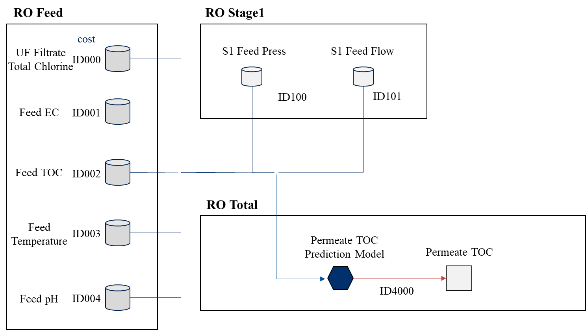
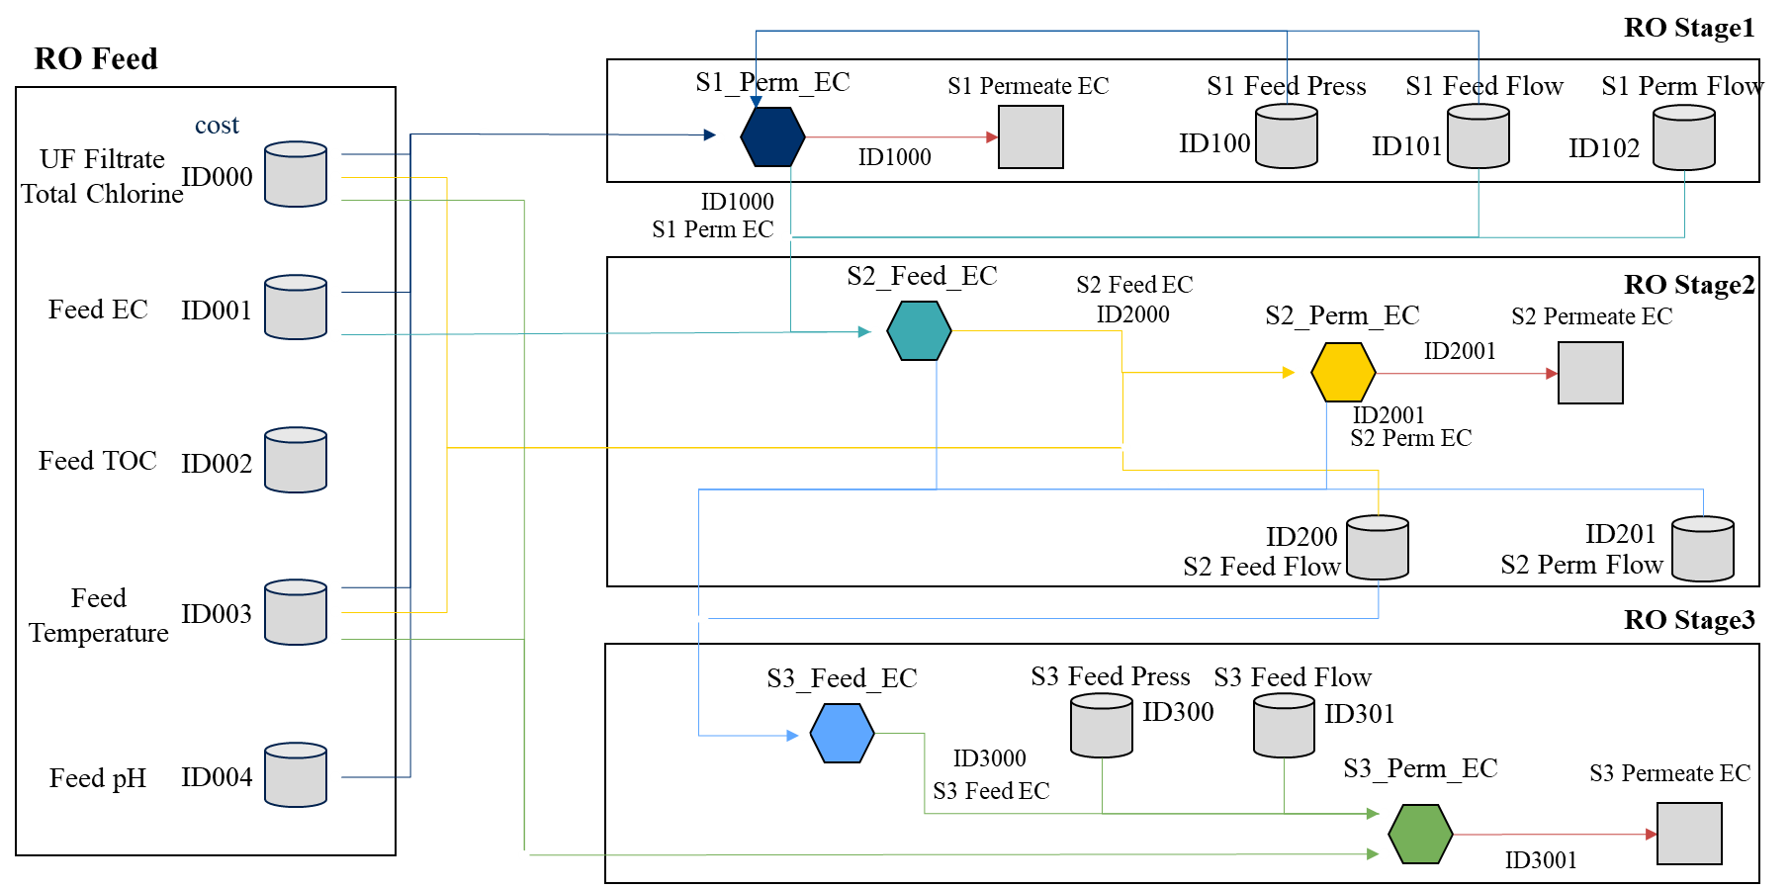
Flow Chart for RO Optimization
3. RO Optimization Simulation > Problem Formulation
We define the flow chart, variables, mathematical models.
The model dose not yet include RO Membrane Scaling / Fouling model.
RO Whole Part
RO Each Stage Part
Predictive Variable
(water quality)
Mathematical Model
(prediction model)
Exogenous Variable
Notes:
This is the flow chart for Las Virgenes model. I divided into the RO whole part and RO each stage part. The storage object is exogenous variable and the square object is predictive variable that is water quality. The hexagon object is mathematical model and have both input and output variable. The arrow toward the object is input variable and the arrow from the object is output variable. Especially, the four objects enclosed in the square are the prediction model constructed by Imoto-san.

Slide 28
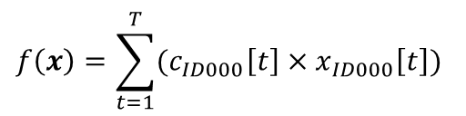
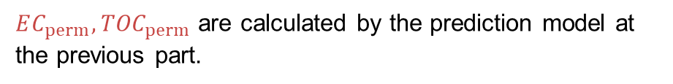
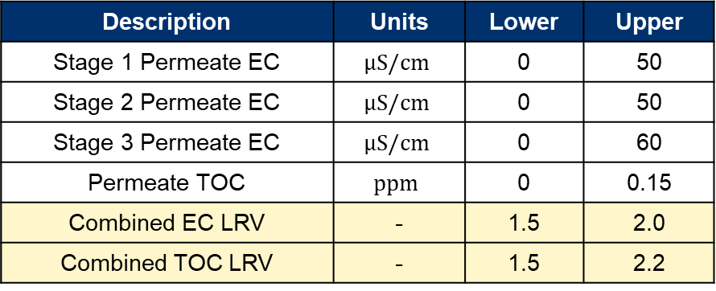
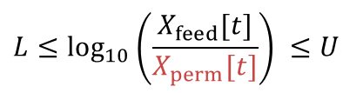
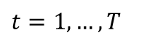
Optimization Problem
3. RO Optimization Simulation > Problem Formulation
Minimizing chemical cost while satisfying water quality standards.
Total Steps
$$f\left(x\right)=\sum_{t=1}^{T}{(c_{ID000}\left[t\right]×x_{ID000}\left[t\right])}$$
Objective Function
UF Filtrate Total Chlorine
Main Constraint Conditions
Water Quality Standards and Upper / Lower limit
Logarithmic Reduction Value (LRV):
Description | Units | Lower | Upper
Stage 1 Permeate EC | $$μS/cm$$ | 0 | 50
Stage 2 Permeate EC | $$μS/cm$$ | 0 | 50
Stage 3 Permeate EC | $$μS/cm$$ | 0 | 60
Permeate TOC | $$ppm$$ | 0 | 0.15
Combined EC LRV | - | 1.5 | 2.0
Combined TOC LRV | - | 1.5 | 2.2
$$L≤\log_{10}\left(\frac{X_{feed}[t]}{X_{perm}[t]}\right) ≤U$$
$$t=1,…,T$$
$EC_{perm}, {TOC}_{perm}$ are calculated by the prediction model at the previous part.
Notes:
In this case, the optimization problem is minimizing the chemical dosing cost while satisfying water quality standards. The objective function f is formulated as the sum of the UF filtrate total chlorine of the optimization period. The main constraint conditions is water quality standards and upper or lower limit. This table shows each upper and lower limit about permeate EC and TOC. Especially, RO process operators monitor the logarithmic reduction value called LRV as standards. The LRV’s upper of EC is 2.5 and LRV’s upper of TOC is 2.0 in Las Virgenes plant. Moreover, the permeate quality values are calculated by the prediction model at the previous part.

Slide 29
Optimization Algorithm
3. RO Optimization Simulation > Optimizer
We must select the optimization algorithm the problem class.
This problem class can be nonlinear or black-box continuous optimization in future efforts of modeling.
Therefore, we use the combined algorithm with some known metaheuristic algorithms.
I wrote the python code from scratch and introduced into the optimization simulator.
Notes:
In this case, the optimization problem is minimizing the chemical dosing cost while satisfying water quality standards. The objective function f is formulated as the sum of the UF filtrate total chlorine of the optimization period. The main constraint conditions is water quality standards and upper or lower limit. This table shows each upper and lower limit about permeate EC and TOC. Especially, RO process operators monitor the logarithmic reduction value called LRV as standards. The LRV’s upper of EC is 2.5 and LRV’s upper of TOC is 2.0 in Las Virgenes plant. Moreover, the permeate quality values are calculated by the prediction model at the previous part.

Slide 30
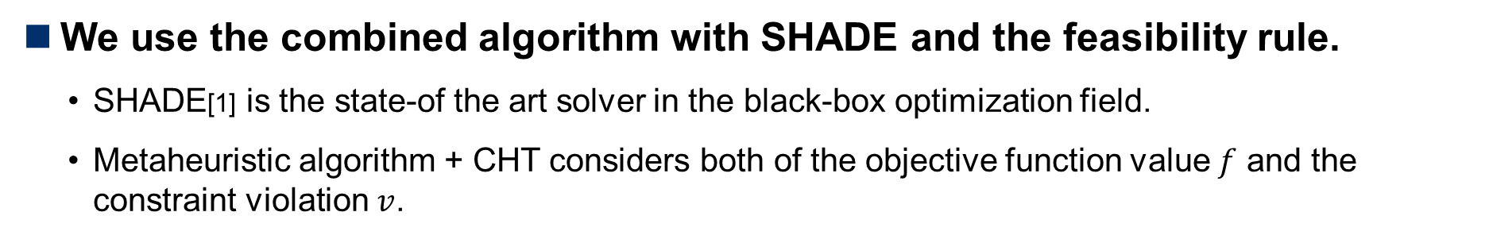
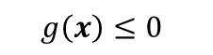
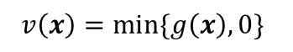
Metaheuristic Algorithm
3. RO Optimization Simulation > Optimizer
We use the combined algorithm with SHADE and the feasibility rule.
SHADE[1] is the state-of the art solver in the black-box optimization field.
Metaheuristic algorithm + CHT considers both of the objective function value $f$ and the constraint violation $v$.
Constraints:
$$g\left(x\right)≤0$$
Amount of Constraint Violation:
$$v\left(x\right)=\min{\{g\left(x\right), 0\}}$$
Unconstrained Prob.
Constrained Prob.
Metaheuristics Algorithm
SHADE, GA etc.
SHADE, GA etc.
+
Constraint Handling Techniques (CHTs)
Feasibility Rule, Static Penalty etc.
None
[1] R. Tanabe et al.: “Success-History Based Parameter Adaptation for Differential Evolution” (2013)
Notes:
Optimization solver for unconstrained nonlinear and Black-box optimization classes as well as Genetic Algorithm.

Slide 31
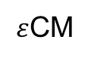
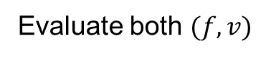
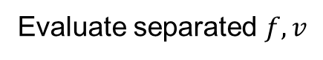
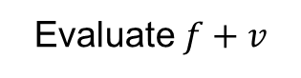
Constraint Handling Techniques
3. RO Optimization Simulation > Optimizer
CHT is divided into 3 classes[2].
Penalty-based CHT
Separatist-based CHT
Multi-objective-based CHT
Method
Evaluate $f+v$
Evaluate separated $f,v$
Evaluate both $(f,v)$
Search Efficiency of Trade-off Region
Low
Middle
High
Computational Complexity
Low
Low
High
Switching
Ranking
Pareto Ranking
Decomposition
Example
Death Penalty,
Feasibility Rule,
MCR
Two-Phase Framework
Adaptive MOEA/D
Adaptive Penalty
$ε$CM
[2] W. Kumagai and K. Yasuda: “Black-Box Optimization and Its Applications,” Innovative Systems Approach for Facilitating Smarter World, Springer Nature Singapore (2023)
Notes:
In this case, the optimization problem is minimizing the chemical dosing cost while satisfying water quality standards. The objective function f is formulated as the sum of the UF filtrate total chlorine of the optimization period. The main constraint conditions is water quality standards and upper or lower limit. This table shows each upper and lower limit about permeate EC and TOC. Especially, RO process operators monitor the logarithmic reduction value called LRV as standards. The LRV’s upper of EC is 2.5 and LRV’s upper of TOC is 2.0 in Las Virgenes plant. Moreover, the permeate quality values are calculated by the prediction model at the previous part.

Slide 32
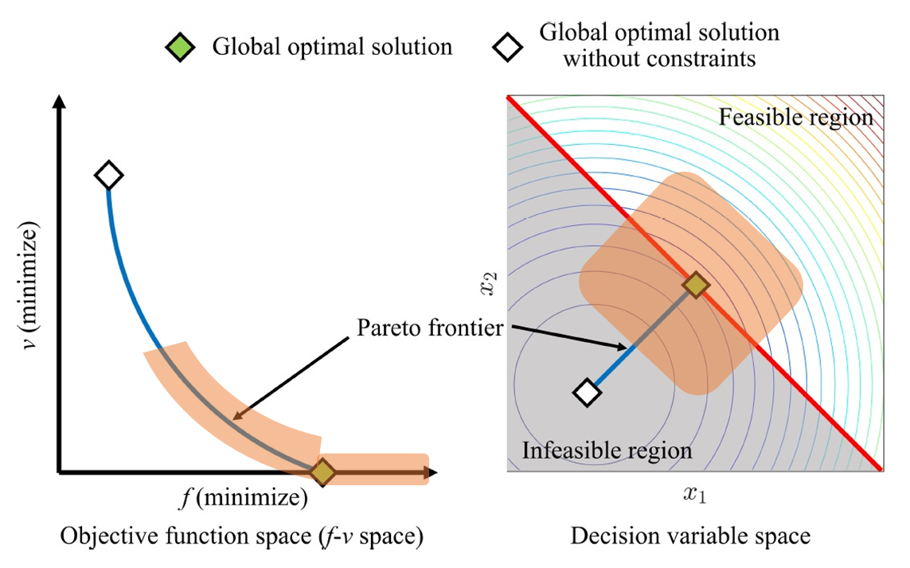




Concept of Feasibility Rule
3. RO Optimization Simulation > Optimizer
Select a solution putting $v$ before $f$.
Selection pressure for the feasible region is STRONG.
If two solutions $x,y$ are compared, use the following rule:
# | Compared | Select
1. | Violated solutions | Lower $v$
2. | Feasible and violated solutions | Feasible solution
3. | Feasible solutions | Lower $f$
Population
1st Step
2nd Step
$f:$Objective Function Value
$v:$Constraint Violation
Notes:
In this case, the optimization problem is minimizing the chemical dosing cost while satisfying water quality standards. The objective function f is formulated as the sum of the UF filtrate total chlorine of the optimization period. The main constraint conditions is water quality standards and upper or lower limit. This table shows each upper and lower limit about permeate EC and TOC. Especially, RO process operators monitor the logarithmic reduction value called LRV as standards. The LRV’s upper of EC is 2.5 and LRV’s upper of TOC is 2.0 in Las Virgenes plant. Moreover, the permeate quality values are calculated by the prediction model at the previous part.

Slide 33




Permeate Water Quality
3. RO Optimization Simulation > Prediction Result
Training Period: from March 7th to 14th, 2022 (1week)
Optimization Period : from March 14th to 21th, 2022 (1week)
1hour interval data
Blue: Actual / Orange: Prediction
The prediction performance for global trends is good.
Combined Permeate TOC [mg/L]
Combined Permeate EC [uS/cm]
Actual Ave.: 0.067 [mg/L],
Predict Ave.: 0.064 [mg/L]
Actual Ave.: 20.76 [uS/cm],
Predict Ave.: 20.87 [uS/cm]
Actual Ave.: 1.83,
Predict Ave.: 1.83
Actual Ave.: 2.01,
Predict Ave.: 2.03
*The results are NOT optimized when input data is fixed to actual data.

Slide 34



Search Solution Transition (during Generations)
3. RO Optimization Simulation > Optimization Results
After getting a feasible solution, the solution is improving $f$.
Best Solution Transition
Population size: 100
Objective Function Value $f(x)$
Constraint Violation $v(x)$
Get feasible solution
(Generations)
*Total calculation time is about 10 minutes.

Slide 35





Chemical and Exogeneous Variables
3. RO Optimization Simulation > Optimization Results
The schedule shows reducing chemical costs comparing to actual data.
Blue: Actual / Orange: Optimized
UF Total Chlorine [mg/L] (Chemical Dosing Cost)
Feed TOC [mg/L] (Fixed)
S1 Feed Pressure [psi] (Fixed)
Actual Ave.: 0.40 [mg/L],
Optimized Ave.: 0.38 [mg/L]
S1 Feed EC [uS/cm] (Fixed)
S1 Feed Flow [gpm] (Fixed)

Slide 36




Water Quality Variable
3. RO Optimization Simulation > Optimization Results
Blue: Actual / Orange: Optimized
There is a little change but meeting the WQ standards of LRV.
Combined Permeate TOC [mg/L]
Combined Permeate EC [uS/cm]
Actual Ave.: 0.067 [mg/L],
Optimized Ave.: 0.063 [mg/L]
Actual Ave.: 20.76 [uS/cm],
Optimized Ave.: 20.87 [uS/cm]
Actual Ave.: 1.83,
Optimized Ave.: 1.83
Actual Ave.: 2.01,
Optimized Ave.: 2.03

Slide 37
Optimization Effect Calculation
3. RO Optimization Simulation > Optimization Effect
There is a little improvement in the period and condition.
This model does NOT yet RO membrane fouling model.
Variable | Actual Ave. | Optimized Ave. | Diff (Opt – Act) | Model Error | Diff – Err.
Total Chlorine [mg/L] | 0.40 | 0.38 | - 0.02 |  | - 0.02
EC [uS/cm] | 20.76 | 20.87 | + 0.11 | + 0.11 | - 0.0004
TOC [mg/L] | 0.067 | 0.063 | - 0.004 | - 0.004 | + 0.0004
LRV EC | 1.83 | 1.82 | - 0.01 | - 0.01 | + 0.002
LRV TOC | 2.01 | 2.03 | + 0.02 | + 0.02 | + 0.003

Slide 38
Future Tasks
3. RO Optimization Simulation > Optimization Effect
To introduce Random Forest into optimization.
Metaheuristic algorithm calls RF 500,000 times, so many calculation time.
To introduce RO membrane Fouling model and determine chemical cost considering RO Fouling.

Slide 39






4. RO Membrane Scaling Modeling
Overview of Scaling Estimation
Overview of Scaling Estimation & Control
Concentration Polarization
Saturation Index
Chemical Dosage
[3]
[1],[2]
$$CaCO_{3}↔Ca^{2+}+CO_{3}^{2−}$$
$$SiO_{2}+{2H}_{2}O↔H_{4}SiO_{4}$$
[4]
[1] https://onl.bz/f1JewkV
[3]https://wwwbrr.cr.usgs.gov/projects/GWC_chemtherm/pubs/wq4fdoc.pdf
[4]Effect of residence time on the degree of CaCO3
precipitation in the presence of an anti-scalant
[2] membrane separations technology
principles and applications
Notes:
Let us start my presentation.
Today’s presentation theme is scaling estimation & control.
Overview is this. This estimation method has 3 steps.
First is concentration polarization, second is Saturation index, third is chemical dosage.
Concentration polarization is a famous chemical dynamics. Please look this trajectory.
It means concentration of feed water. And Black box is membrane.
Concentration is increasing as location approach the membrane surface.
Scaling is occurred on membrane surface, this dynamics is too important.
Okey next. Saturation index indicate relationship between actual ion concentration and equilibriums one.
So, calculating Saturation index, we can understand scaling is occurred or not.
Last one is chemical dosage. According to this paper feature value of chemical dosage, x-axis, and actual ion concentration , y axis, have positive correlation.
Therefore, using this model and SI results, we can determine the chemicals dosage.
This is the overview of scaling estimation.
In following slides, I’ll introduce about specific example of concentration polarization and saturation index.

Slide 40


Calculation Methods : Concentration Polarization
4. RO Membrane Scaling Modeling
Step1 : Calc parameter from data sheet
mass transfer coefficient$K_{w}$ $K_{w}=\frac{J_{v}}{∆P_{w}−π_{NaCl}}$ $J_{v}=coef∗\frac{Perm Flow Rate_{i}}{Active Area}, π_{NaCl}=C_{NaCl}RT, ∆P_{w}=150 ∗6894$
Step2 : Calc brine EC and $π$ at each stage
${EC}_{i,brine}= \frac{Q_{i,feed} ×{EC}_{i,feed}−Q_{i,perm}×{EC}_{i,perm}}{Q_{i,feed} −Q_{i,perm}}$
$π_{i,j}=C_{i,j}RT=Coef∗EC_{i,j} RT$
Step3 : Calc $K_{i}$form ${ J}_{v}$ , $π$ and $∆P_{trans, i}$
${J_{v}}_{solv}=K_{w}∗∆P_{trans_{i}}{ J}_{v_{salt_{i}}}=coef∗\frac{Perm Flow Rate_{i}}{Active Area}$
$k_{i}=\frac{{J_{v}}_{salt_{i}}}{\ln\left(\frac{∆P_{trans, i}}{π_{i,brine,}−π_{i,perm}}×\left(1−\frac{{J_{v}}_{salt_{i}}}{{J_{v}}_{solv_{i}}}\right)\right)}$
$coef$ means unit transformation coefficient
$i,j$” denotes RO stage number, locations (feed, membrane surface, permeate, brine)
Notes:
Calculation method of concentration polarization are followings. In this presentation, I’ll spare you the details of this methods.
Please read this textbook. If you want to take same copy, please call me.

Slide 41


Calculation Methods : Concentration Polarization
4. RO Membrane Scaling Modeling
Step4 : Calc concentration on membrane surface
$C_{i,memb,m}=\left(C_{i,brine,m}−C_{i,perm,m}\right)×e^{\frac{{J_{V}}_{solv_{i}}}{k_{i,m}}}+C_{i,perm,m}$
Figure omitted for confidentiality reasons.
Notes:
Finally, results of concentration polarization is this.
Left figure is 1st stage, right figure is 3rd stage result of Si concentration polarization.
In both figure,x axis means date, y axis means Si concentration.
Look at left fig.bule dash line is 1st stage feed concentration and blue line means concentration polarization results of 1st stage. As you know, CP results is bigger than feed concentration and 3rd stage results is bigger than that of 1st stage.

Slide 42







Calculation Methods : Saturation Index
4. RO Membrane Scaling Modeling
https://www.sci.kagoshima-u.ac.jp/kawano/clay_mineralogy/genesis.pdf
What is Saturation Index(SI)?
Assumption
Eq (4.12) is satisfied following slides.
$$Ca^{2+}+2F^{−}⇆CaF_{2}$$
$$SI>0$$
SI Example
$$SI=0$$
$$SI<0$$
Notes:
Next I introduce about Saturation index (SI),off cause it does not mean silicon.
According to the this pdf, saturation index’s detail are written in here.
If we think about this reaction, definition of SI is this.
IAP equal Actual state of this reaction, of cause brackets of C means concentration of C.
And, K express equilibrium state of this reaction.
So, SI bigger than zero, equilibrium is shifted to the right side.
For example, we consider this reaction, If $SI>0$, calcium fluoride salt is precipitated.
Next, we assume this, to say simply, ion concentration is less than a certain threshold.

Slide 43



Calculation Methods : Saturation Index
4. RO Membrane Scaling Modeling
Calculate “SI” using USGS software
software can calculate “SI” depends on following equations
[3]https://wwwbrr.cr.usgs.gov/projects/GWC
_chemtherm/pubs/wq4fdoc.pdf
…
Key point
$$\frac{d\ln{K}}{dT}≅\frac{∆H^{0}}{RT^{2}}$$
$$K:equilibrium constant$$
$$∆H^{0}:standard enthalpy of reaction$$
$$R:Gas Constant$$
$$T:Temprature$$
…
…
Notes:
I calculate saturation index using this software.
This software can calculate saturation index depends on following equations,
Including one of the scaling causes calcite and silica gel.
Key point is this, temperature derivative of $equilibrium constant$ refer to $standard enthalpy of reaction$
so, relationship between calcite and temp. are negative, but that of silica gel is positive.

Slide 44

Calculation Methods : Saturation Index
4. RO Membrane Scaling Modeling
Si concentration vs. “SI”
Problem settings
All parameters without Si concentration are fixed
Changing Si concentration from 0 to 450[mg/L]
Relationship between Anti-Scalant and Concentration
Focus on 3rd stage polarization
Figure omitted for confidentiality reasons.
Need Anti-Scalant
0.37
0
Notes:
First, I calculate SI following settings.
-All parameters without Si concentration are fixed for example, Temperature, Conductivity etc. .
-Changing Si concentration from 0 to 450[mg/L]
The saturation index is shown to be changing as the si concentration changes.
The result of this calculation, performed once a day for 151 days, is shown on the right fig.
Red dash line’ concentration are satisfied SI = 0.37,
it means if 3rd stage concentration polarization results, blue line is lager than red dash line,
We must use chemical.

Slide 45



Calculation Methods : Saturation Index
4. RO Membrane Scaling Modeling
$$\frac{d\ln{K}}{dT}≅\frac{∆H^{0}}{RT^{2}}$$
Si concentration vs. “SI”
Problem settings
All parameters without Si concentration are fixed
Changing Si concentration from 0 to 450[mg/L]
Relationship between Inverse Operation and Temperature
Figure omitted for confidentiality reasons.
[℃]
0.37
0
[℃]
Notes:
Finally, I'll end my own presentation by looking at the relationship between temperature and the key points I mentioned earlier.
Blue line means Ca and Si concentration that satisfy SI = 0.37.
Ca inverse operation result and temperature have negative correlation,
But Si inverse operation result and temperature have positive correlation.
It indicates the need to change the control depending on the temperature.
My presentation is all. Any question?

Slide 46
Q&A / Discussion
4. RO Membrane Scaling Modeling

Slide 48
[LVMWD] RO System Configuration and Measurement Points
・Feed Free Chlorine
・Feed Conductivity
・Feed pH, TOC, Temp
・Feed Pressure
・Feed Flow (Calc)
・Inlet Free Chlorine
・Inlet Total Chlorine
・Inlet pH
・Inlet UVT
・Inlet Flow
・Outlet Free Chlorine
・Outlet Total Chlorine
・Inlet UVT
a
・Permeate Flow
・Permeate Conductivity
・Combined Permeate TOC
・Combined Permeate Conductivity
RO 1st Stage
UV
P
This pump decides the feed flow to RO.
Feed Pressure
b
・Permeate Flow
・Permeate Conductivity
RO 2nd Stage
・UV Dose
・UV Intensity
・UV Lamp Power (Constant 50%)
d
・Permeate Flow
・Permeate Conductivity
c
Feed Pressure
Concentrate Pressure
RO 3rd Stage
P
<Differential Pressure>
Stage 1 = －
Stage 2 = －
Stage 3 = －
a
b
e
b
c
・Concentrate Pressure
・Concentrate Flow
d
e

Slide 49
Data Preprocessing
2. RO Permeate Water Quality Prediction
Step1 : Data Cleaning Getting rid of the data during the period when it is as following: ① First Feed Flow Rate equal 0, ② The measurement value remains same value for more than 10 mints, ③ Changing rate of measurement value is more than 20% ( / mint) and etc.
y=0
①
Y
DATE
②
More than 10 min
Y
Feed Flow Rate Raw Data
Zoom up
DATE
③
Changing rate
More than 20%
Y
DATE
Step2 : Filtering This step (ⅰ or ⅱ) is applied only when step1 pretreatment does not have enough efficacy.
Analysis of Variance（Removing the outlier which is beyond 3σ.）
Kalman Filter is applied.

Slide 50
Overview of the water quality prediction model
2. RO Permeate Water Quality Prediction
Focused Period: July 1st, 2021 ~ July 27th, 2022
all variables are available and operational situation with RO membrane is stable.
Target Variables: 1st to 3rd stage permeate conductivity and combined TOC
Treated water is required to satisfy the standard indicated permeate conductivity and TOC.
RO system
Target④
Target①
Target②
measuring point
Target③
P
pump
RO Permeate Water Quality Prediction targets are Target①~④

Slide 51

2. RO Permeate Water Quality Prediction > Results by Multiple Linear Regression
A-1：Prediction results from systematically pre-processed data
～ Target ② Stage2 Permeate EC ～
Pre-processed actual data
Predicted data
Index | Stage2 Permeate EC
RMSE | 2.46* (uS/cm)
MAPE | 5.59* (%)

Slide 52

2. RO Permeate Water Quality Prediction > Results by Multiple Linear Regression
A-1：Prediction results from systematically pre-processed data
～ Target ③ Stage3 Permeate EC ～
Pre-processed actual data
Predicted data
Index | Stage3 Permeate EC
RMSE | 2.30* (uS/cm)
MAPE | 4.70* (%)

Slide 53

2. RO Permeate Water Quality Prediction > Results by Random Forest
B-1：Prediction results from systematically pre-processed data
～ Target ② Stage2 Permeate EC ～
Pre-processed actual data
Predicted data
Index | Stage2 Permeate EC
RMSE | 1.40* (uS/cm)
MAPE | 4.37* (%)

Slide 54

2. RO Permeate Water Quality Prediction > Results by Random Forest
B-1：Prediction results from systematically pre-processed data
～ Target ③ Stage3 Permeate EC ～
Pre-processed actual data
Predicted data
Index | Stage3 Permeate EC
RMSE | 2.02 (uS/cm)
MAPE | 4.06 (%)

Slide 55

Variable List
LVMWD
ID No. | Description | Units | Opt. Variable / Fixed Parameter
ID0000 | UF Filtrate Total Chlorine | ton/day | Optimization Variable
ID0001 | Feed EC | $$μS/cm$$ | Fixed Parameter
ID0002 | Feed TOC | mg/L | Fixed Parameter
ID0003 | Feed Temperature | $$℉$$ | Fixed Parameter
ID0004 | Feed pH | - | Fixed Parameter
ID0100 | Stage 1 Feed Pressure | psi | Fixed Parameter
ID0101 | Stage 1 Feed Flow Rate | gpm | Fixed Parameter
ID0102 | Stage 1 Permeate Flow Rate | gpm | Fixed Parameter
ID0200 | Stage 2 Feed Flow Rate | gpm | Fixed Parameter
ID0201 | Stage 2 Permeate Flow Rate | gpm | Fixed Parameter
ID0300 | Stage 3 Feed Pressure | psi | Fixed Parameter
ID0301 | Stage 3 Feed Flow Rate | gpm | Fixed Parameter
ID1000 | Stage 1 Permeate EC | $$μS/cm$$ | Intermediate Variable
ID2000 | Stage 2 Feed EC | $$μS/cm$$ | Intermediate Variable
ID2001 | Stage 2 Permeate EC | $$μS/cm$$ | Intermediate Variable
ID3000 | Stage 3 Feed EC | $$μS/cm$$ | Intermediate Variable
ID3001 | Stage 3 Permeate EC | $$μS/cm$$ | Intermediate Variable
ID4000 | Permeate EC | $$μS/cm$$ | Intermediate Variable
ID4001 | Permeate TOC | mg/L | Intermediate Variable

Slide 56




透過水質
2.2 OCWD > 1st week 予測結果
Blue: Actual / Orange: Prediction
トレンドを大まかに捉えているが、ECの予測値が実績よりも若干低い。
Combined Permeate TOC [ppm]
Combined Permeate EC [uS/cm]
Actual Ave.: 0.055 [ppm],
Predict Ave.: 0.052 [ppm]
Actual Ave.: 23.48 [uS/cm],
Predict Ave.: 18.61 [uS/cm]
Actual Ave.: 2.22,
Predict Ave.: 2.24
Actual Ave.: 1.88,
Predict Ave.: 1.99

Slide 57

探索結果（最良解の推移）
2.2 OCWD > 1st week 最適化結果
実行可能解を得て、コストを改善する解が得られている。
Blue: Objective Function Value $f(x)$ /
Orange: Constraint Violation $v(x)$
約9分
10,000の半分で止めた

Slide 58






操作計画：コスト変数と固定変数
2.2 OCWD > 1st week 最適化結果
LRV基準の制約によって、Inhibitorが実績とほぼ同じ値になっている。
Blue: Actual / Orange: Optimized
流入TOC [ppm]（固定）
S1流入圧力 [psi]（固定）
Sulfuric Acid [ton/hour]（コスト）
Inhibitor [ton/hour] （コスト）
S1流入EC [uS/cm]（固定）
S1流入量 [gpm]（固定）
Actual Ave.: 0.39 [ton/hour],
Optimized Ave.: 0.38 [ton/hour]
Actual Ave.: 0.0559 [ton/hour],
Optimized Ave.: 0.0560 [ton/hour]

Slide 59




操作計画：透過水質
2.2 OCWD > 1st week 最適化結果
Blue: Actual / Orange: Optimized
ECのLRV基準の上限に位置する解となっている。
Combined Permeate TOC [ppm]
Combined Permeate EC [uS/cm]
Actual Ave.: 0.055 [ppm],
Optimized Ave.: 0.053 [ppm]
Actual Ave.: 23.5 [uS/cm],
Optimized Ave.: 18.7 [uS/cm]
Actual Ave.: 2.22,
Optimized Ave.: 2.23
Actual Ave.: 1.88,
Optimized Ave.: 1.98

Slide 60
コスト換算
2.2 OCWD > 1st week 最適化結果
約47$/day(18K$/year, 2.5M\/year)の削減効果と見積もれる。
ただし、この条件では、ほぼ改善の余地が無いと見積もれる。
Variable | Actual Ave. | Optimized Ave. | Diff (Opt – Act) | Model Error | Diff – Err. | Cost [$/day]
Acid [ton/hour] | 0.39 | 0.38 | - 0.009 |  | - 0.009 | - 53.3
Inhibitor [ton/hour] | 0.0559 | 0.0560 | + 0.0001 |  | + 0.0001 | + 6.22
EC [uS/cm] | 23.5 | 18.7 | - 4.74 | - 4.87 | + 0.13
TOC [mg/L] | 0.055 | 0.053 | - 0.002 | - 0.003 | + 0.001
LRV EC | 1.88 | 1.98 | + 0.30 | - 0.01 | - 0.003
LRV TOC | 2.217 | 2.234 | + 0.02 | + 0.02 | - 0.005
Total |  |  |  |  |  | - 47.1

